Slide 1
GCSE Learning for Life and Work
2022-2024

Slide 2
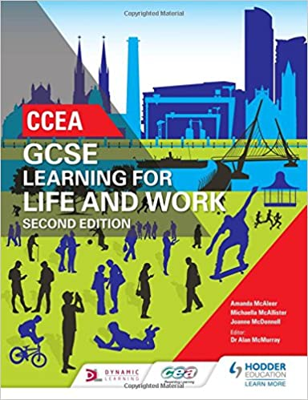
What is Learning for Life and Work?
LLW is broken down into 4 units – 3 of these units are assessed through an exam, 1 of these is a Controlled Assessment (40%)
The 3 exam units are:
Local and Global Citizenship
Personal Development
Employability

Slide 3
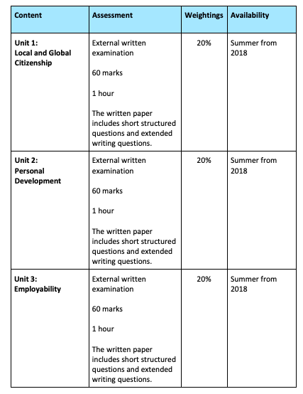

Slide 4
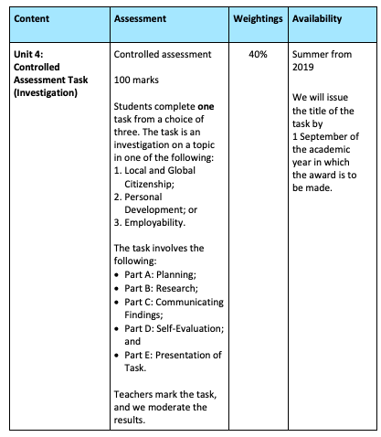

Slide 5
Unit 1 – Local and Global Citizenship (20%)
In a nutshell, this unit teaches you about our society. We look at topics such a diversity, social equality, human rights and inclusion to name a few.
Students find this unit very interesting as we look at how Northern Ireland has been shaped into what it is today.

Slide 6
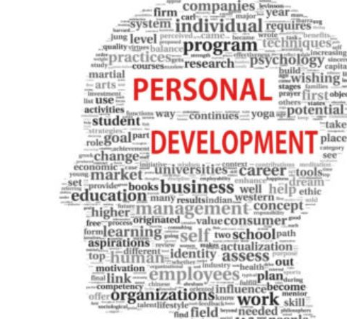
Unit 2 – Personal Development (20%)
This unit covers topics such as alcohol and drug abuse, responsible parenting, relationships and sexuality and making informed financial decisions.
This unit is enjoyed by all students as they feel that they can relate to the topics that are covered. Students have always performed very well in this unit.

Slide 7
Unit 3 – Employability (20%)
This unit looks at how globalisation has had an impact on employment, the rights and responsibilities in the workplace, how to apply for jobs, being self-employed, etc.
Students enjoy this unit as it gives them a good understanding of what is expected when they leave school and enter the world of work.

Slide 8
Unit 4 – Controlled Assessment (40%)
Each year CCEA release 3 different titles to base your controlled assessment on. Each of these titles is based on units 1-3.
This piece of work is completed in school and is assessed by your teacher. It is then sent off to CCEA for moderation.
Just think of this unit as a piece of coursework that can get you 40% of your GCSE!

Slide 9
Any questions?
If you have any questions at all about Learning for Life and Work you can call up and see me ☺
OR
You can send me an email on lmcveigh524@c2ken.net

